Slide 1

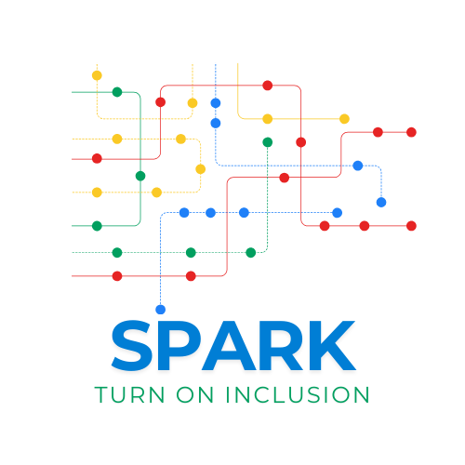


Capacity Building Program for Youth Workers
Building Self-Advocacy and Independent Living Skills
Developed by: OTB Europe

Slide 2
Learning Outcomes
After completing this module, you will have gained the following knowledge, skills and attitudes.
L01.
L02.
L03.
Understand the core concepts of self-advocacy and independent living for youth with intellectual and psychosocial disabilities.
Learn practical methods to support youth in developing decision-making, communication, and life management skills.
Gain tools to foster autonomy, build confidence, and promote active participation in both personal and political life.

Slide 3

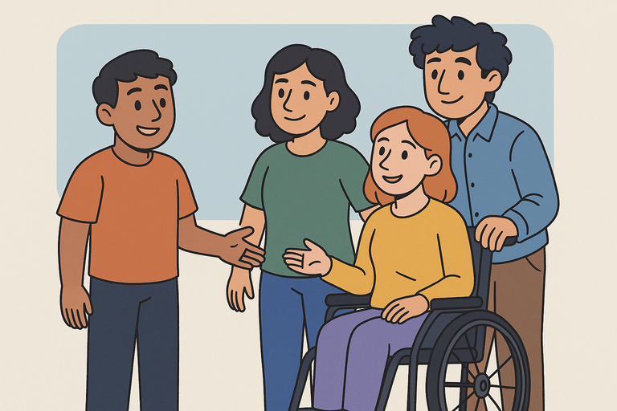
Introduction
Building Self-Advocacy and Independent Living Skills
Young people with intellectual and psychosocial disabilities often face barriers not only in political engagement, but also in everyday decision-making, communication, and autonomy. Without the skills and support to live independently and advocate for themselves, full inclusion becomes difficult.
This module equips youth workers with inclusive, rights-based tools to foster self-advocacy and independent living skills. These are essential not just for personal development, but for enabling active civic and political participation — a core aim of the SPARK project and the EU Strategy for the Rights of Persons with Disabilities (2021–2030).
Notes:
‹#›

Slide 4
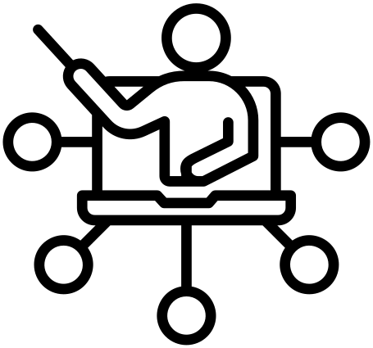
Key Concepts
Person-Centered Planning
Self-Advocacy
The ability to speak up for oneself, express needs and preferences, and make informed choices. In the context of disability, self-advocacy is both a right and a skillset that must be intentionally developed.
An approach that places the young person at the center of all planning and decisions, respecting their voice, goals, and lived experience.
Independent Living
The Role of the Youth Worker
Youth workers are facilitators of empowerment, not gatekeepers of support.
Their role is to:
Promote choice and control in a youth’s life
Adapt communication to be accessible and respectful
Encourage participation in decision-making processes
Provide opportunities for skill-building in safe, inclusive environments
The right to make decisions about one’s own life and live with the greatest degree of autonomy possible — with or without support. This includes managing daily tasks, building relationships, and navigating systems.

Slide 5
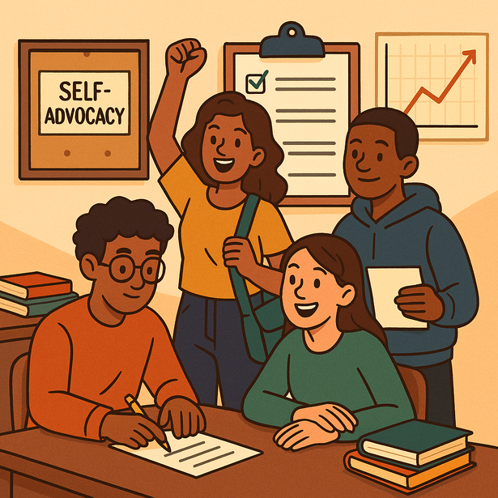
Understanding Self-Advocacy
Self-advocacy is the ability to understand and express one’s needs, rights, and preferences. It is especially important for young people with intellectual and psychosocial disabilities, who are often excluded from decision-making in their lives.
For many, decisions about education, health, housing, or civic engagement are made by family members, professionals, or institutions. Self-advocacy gives power back to the individual—helping young people take control of their future.
Key aspects of self-advocacy include:
Awareness of rights (e.g. under the UN Convention on the Rights of Persons with Disabilities)
Confidence to speak up—in meetings, public spaces, or everyday situations
Support to make decisions—through accessible information and trusted allies
Notes:
‹#›

Slide 6
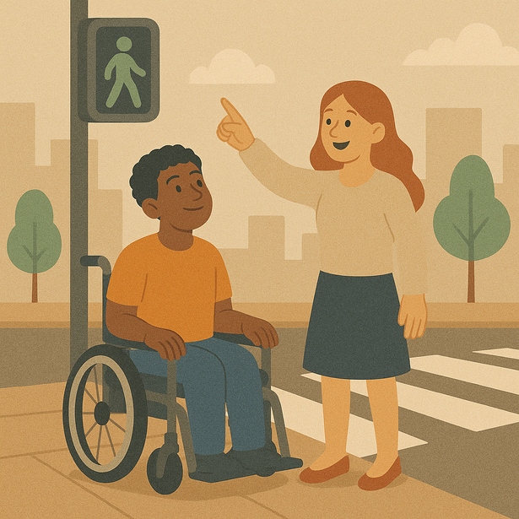
What Is Independent Living?
Independent living is not the same as living alone. Instead, it means having the freedom and support to live your life on your own terms.
This includes:
Making decisions about how you live
Choosing who supports you, and how
Accessing services, transport, and opportunities in the community
For young people with disabilities, building independent living skills can include:
Time management and daily routines
Financial literacy and budgeting
Navigating health care, education, or housing systems
Asking for help or using assistive tools
These skills grow with practice—and youth workers are key allies in supporting that growth.
Notes:
‹#›

Slide 7

Barriers and Solutions
Youth with intellectual and psychosocial disabilities often face:
Overprotection, which limits independence
Stigma or low expectations from adults
Information that’s too complex or inaccessible
Lack of choice or voice in decisions
Notes:
‹#›

Slide 8
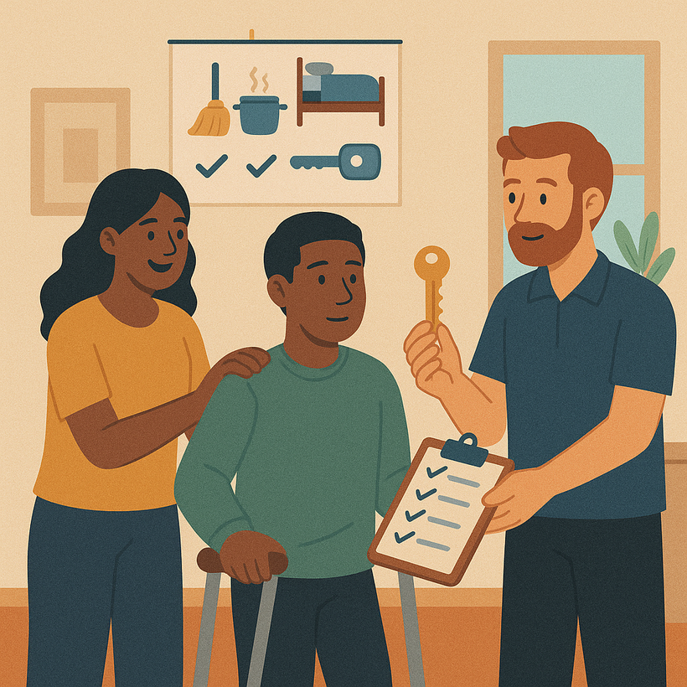
Youth workers can help by:
Using Easy-to-Read or visual formats
Providing structured decision-making support
Modeling respectful communication and boundaries
Encouraging risk-taking in safe environments
Notes:
‹#›

Slide 9
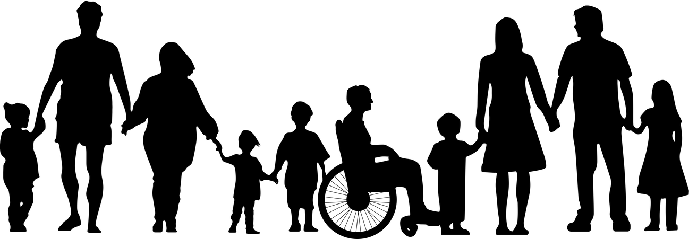
Supporting Evidence with Quantitative Data
“The Impact of Self-Determination on the Post-School Outcomes of Youth with Disabilities” (Michael L. Wehmeyer & colleagues, 2012 – University of Kansas)
This longitudinal study tracked 80 youth with intellectual and developmental disabilities over 1 to 3 years after high school.
Participants were divided into two groups:
Group A received explicit training in self-determination and self-advocacy (e.g., goal-setting, decision-making, and self-regulation).
Group B received typical support services without structured training in self-determination.
Notes:
‹#›

Slide 10
Supporting Evidence with Quantitative Data
Results:
Employment:
73% of youth in Group A were employed one year after graduation
Compared to 43% in Group B
Independent Living:
40% of youth in Group A lived independently or semi-independently
Compared to 23% in Group B
Community Participation:
Youth in Group A were significantly more likely to report participating in civic and community events, such as voting or attending meetings.
Notes:
‹#›

Slide 11
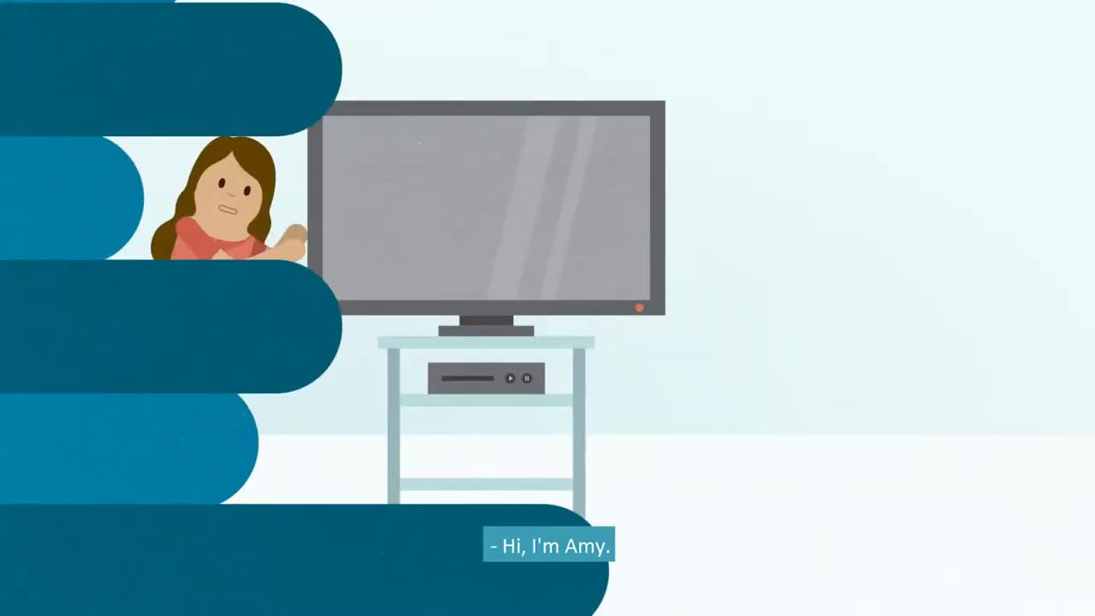

Slide 12
7
Activity 1 – “My Choices, My Voice”
Objective:
Help participants learn how to support young people in making their own decisions without taking control.
Duration: 30 minutes
Group Size: 3–5 people
Materials: Situation cards, flipchart paper, markers
Steps:
Hand out real-life scenario cards, such as:
“Going to the doctor alone”
“Choosing what to wear for an interview”
“Deciding to attend a local political meeting”
Each group discusses how to support a young person to make that choice—without making the decision for them.
Notes:
‹#›

Slide 13

7
Activity 1 – “My Choices, My Voice”
Groups write down practical strategies, e.g.:
Providing information in accessible formats
Talking through options calmly
Using visuals or symbols to support understanding
Groups share their strategies with the others.
Final reflection: What does it really mean to respect someone’s autonomy?
Notes:
‹#›

Slide 14
7
Activity 2 – “Living Independently: The Daily Plan”
Objective:
Encourage participants to build structured daily routines adapted to young people’s needs and strengths.
Duration: 40 minutes
Materials: Large schedule template, visual icons/stickers, pens
Steps:
Show an example of a disorganized daily routine for a young person struggling with independence.
Ask each group to build a visual, step-by-step daily plan that includes:
Breaks and meals
Social or leisure time
Hygiene and self-care tasks
Notes:
‹#›

Slide 15
7
Activity 2 – “Living Independently: The Daily Plan”
Include support strategies such as:
Alarms or visual reminders
Quiet zones or sensory-friendly spaces
Peer or family support
Groups present their plans.
Discuss:
What challenges might young people face in following this routine?
How can youth workers help?
Notes:
‹#›

Slide 16

Tips or Steps for Youth Workers
Tip 1 - Start with Their Voice
Tip 3 - Tip 3 – Support Choice-Making
Always begin by asking the young person what they want. Support their goals and preferences, even if they differ from others' expectations.
Self-advocacy starts with being heard.
Encourage everyday decisions: what to wear, where to sit, whether to participate.
Decision-making builds confidence and independence.
Tip 2 - Break Down Tasks into Clear Steps
Tip 4 - Respect Boundaries
Use visual aids and plain language to make complex tasks easier to understand.
Example: “Prepare lunch” becomes → “Wash hands → Choose sandwich → Use toaster.”
Teach that saying “no” is okay—and mean it when they do.
Autonomy includes the right to decline.

Slide 17


7
Which of the following best describes self-advocacy?
A. Telling others what a young person wants on their behalf
B. Giving young people all the decisions to make with no support
C. Supporting young people to express their needs, make choices, and speak up for themselves
D. Avoiding decisions so no one feels pressured
Notes:
‹#›

Slide 18


7
Which of the following best describes self-advocacy?
A. Telling others what a young person wants on their behalf
B. Giving young people all the decisions to make with no support
C. Supporting young people to express their needs, make choices, and speak up for themselves
D. Avoiding decisions so no one feels pressured
Self-advocacy means supporting young people to speak and act for themselves.
Notes:
‹#›

Slide 19
7
What is a good way to support independent living?
A. Do everything for them to avoid mistakes
B. Give one big instruction at a time
C. Create a daily routine with them using visuals
D. Only focus on political topics
Notes:
‹#›

Slide 20
7
What is a good way to support independent living?
A. Do everything for them to avoid mistakes
B. Give one big instruction at a time
C. Create a daily routine with them using visuals
D. Only focus on political topics
Visual, structured routines help build life skills and reduce stress.
Notes:
‹#›

Slide 21
7
Why is it important to respect when a young person says “no”?
B. To respect their right to set boundaries
A. To avoid arguments
C. Because they’re always right
D. To end the conversation quickly
Notes:
‹#›

Slide 22
7
Why is it important to respect when a young person says “no”?
B. To respect their right to set boundaries
A. To avoid arguments
Saying “no” is a key part of autonomy and self-determination.
C. Because they’re always right
D. To end the conversation quickly
Notes:
‹#›

Slide 23
7
Conclusion- summary
Building self-advocacy and independent living skills isn’t just about teaching life tasks — it’s about changing how young people see themselves and how the world sees them.
As a youth worker, you are in a unique position to:
Create space for young people to lead their own lives
Shift power by offering support without control
Champion their rights, voices, and choices—every day
Remember:
Autonomy is not about doing everything alone — it’s about having control over one’s own path, with support when needed.
Participation begins in daily life — in small choices, everyday routines, and conversations where young people are heard and respected.
Inclusion means more than presence — it means voice, influence, and dignity.
Notes:
‹#›

Slide 24







Funded by the European Union. Views and opinions expressed are however those of the author(s) only and do not necessarily reflect those of the European Union or European Education and Culture Executive Agency (EACEA). Neither the European Union nor the granting authority can be held responsible for them.

