Slide 1




Capacity Building Program for Youth Workers
Inclusive Communication & Engagement
(with focus on ASD and ADHD)
Developed by: MIRA’M

Slide 2
Learning Outcomes
After completing this module, you will have gained the following knowledge, skills and attitudes.
L01.
L02.
L03.
Understand the main characteristics of Autism Spectrum Disorder (ASD) and Attention Deficit Hyperactivity Disorder (ADHD).
Recognise the barriers faced by these young people in political processes and participation.
Design activities adapted to target group needs.

Slide 3

Key Concepts
Background information
Definition 1
Traditionally, political and youth participation spaces have been inaccessible to neurodivergent young people.
Fast-paced group dynamics, noisy environments or implicit social norms can be exclusionary.
Many youth workers have not received specific training on how to adapt activities for young people with ASD or ADHD.
The need for an inclusive and rights-based approach increases.
ASD: Autism Spectrum Disorder.
What it is: A neurodevelopmental condition that affects the way a person communicates, interacts socially and perceives the world.
How it manifests: Difficulties interpreting implicit social norms, need for routines, sensory sensitivity, different ways of processing information.
Political participation: May require clear instructions, more time to process ideas, alternative forms of expression (written, visual, structured).
Key Concept 1
Definition 2
Neurodiversity recognises that neurological differences such as autism and ADHD are part of human variability. From this perspective, the aim is not to ‘normalise’ behaviour, but to adapt environments so that all young people can participate fully in democratic and community life.
ADHD: Attention Deficit Hyperactivity Disorder.
What it is: A neurodevelopmental disorder characterised by high levels of inattention, impulsivity and/or hyperactivity.
How it manifests: Difficulty sustaining prolonged attention, need to move, impulsivity in speaking or acting, organisational problems.
Political involvement: Can benefit from short, dynamic tasks, clear structures, frequent pauses and visual tools.

Slide 4

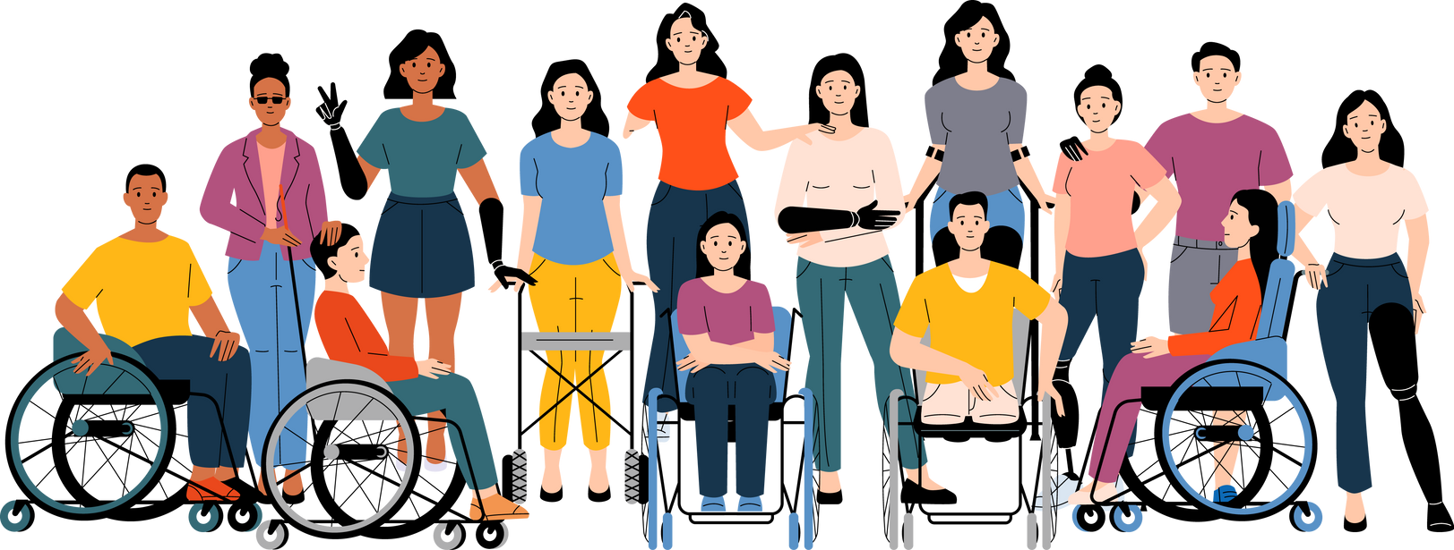
Understanding ASD & ADHD:
behavioral and communication needs
ASD and ADHD are neurodevelopmental disorders that affect behaviour, communication and attention.
In youth settings, it is essential to understand their characteristics in order to ensure equitable participation.
Youth workers must be prepared to create accessible, respectful and adapted environments that encourage the active participation of young people with ASD and ADHD.
This presentation provides practical tools to support inclusion and enhance the quality of life of young people with ASD and ADHD.
Notes:
‹#›

Slide 5

Understanding ASD
Sensory processing: Autistic people may be hypersensitive to noise, bright lights or highly stimulating environments. Political meetings or discussion spaces should be as sensory accessible as possible.
Communication and social interaction: Some young people with autism may have difficulty interpreting non-verbal expressions, irony or implicit social norms. It is essential to ensure clear, structured and direct communication.
Need for routine and predictability: Unexpected changes in schedules, activities or interlocutors may cause stress. It is recommended to provide advance agendas, accessible materials and structured environments.
Notes:
‹#›

Slide 6

Understanding ADHD
Attention deficit: People with ADHD may have difficulty sustaining attention for long tasks, extended conversations or complex instructions. Brief, visual and concrete messages should be used.
Hyperactivity and impulsivity: It is important to allow for pauses, movement and active participation rather than demanding prolonged attention in passive formats (such as long lectures).
Time management and organisation: The use of visual reminders, accessible calendars and planning support helps facilitate their participation.
Notes:
‹#›

Slide 7
Communication styles: what works
Routines and predictibility
Clarity and Specificity
Use short, direct, and clear instructions.
Clearly define tasks step-by-step.
Avoid using idioms, metaphors, or figurative language, as these can be confusing.
Communicate changes or adjustments well in advance.
Clearly outline daily or weekly schedules to establish predictable routines.
Consistency provides a sense of security and helps manage stress levels.
Visual Support
Patience and respect
Integrate visuals such as images, pictograms, or diagrams to enhance comprehension.
Visual aids help individuals with autism process information more effectively.
Tools such as social stories or visual schedules can improve engagement and reduce anxiety.
Allow sufficient time for the person to respond or process new information.
Listen actively and validate their feelings or concerns.
Respect individual communication preferences, such as preferred methods or comfort with eye contact

Slide 8
Communication styles:
What doesn’t work
Unexpected changes
Excesive verbal communication
Using too many words or giving overly detailed explanations can overwhelm.
Limit verbal overload by focusing on essential information and providing brief, structured explanations.
Pair verbal instructions with visuals whenever possible.
Abrupt changes to schedules or routines without prior notice often create anxiety and distress.
Lack of advance preparation can significantly disrupt daily functioning.
Always communicate anticipated changes clearly and provide reassurance or support strategies when necessary.
Ignoring Non-Verbal Communication
Ambiguity and Vague Instructions
Failing to recognize or respect an individual’s non-verbal cues such as body language, facial expressions, or gestures.
Avoid insisting on eye contact or physical interactions if it causes discomfort.
Recognize and accommodate individual differences in communication preferences.
Avoid instructions that are unclear, abstract, or open-ended.
Indirect statements or questions can lead to confusion or misinterpretation.
Always aim for concrete language and clearly defined expectations.

Slide 9
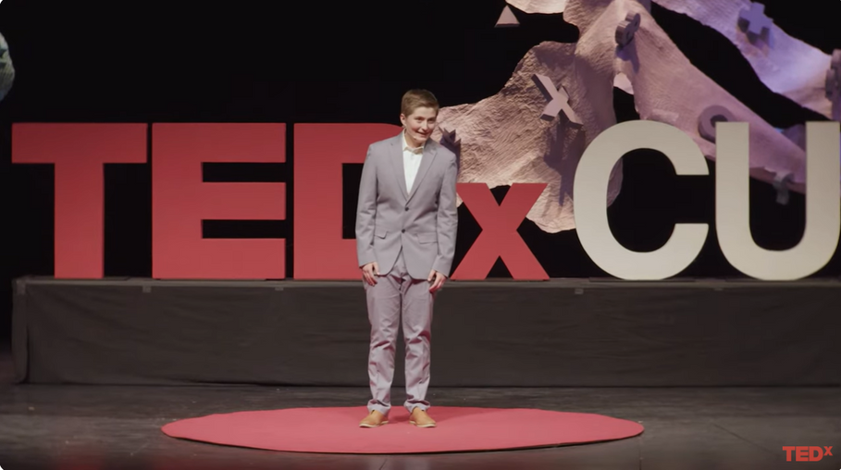


Communication styles:
Kalen Sieja is a student at the University of Colorado Boulder. In his capacity as an engaged political activist, he hopes to utilize his strengths as an autistic person to advance justice, equity, and inclusion.
What autistic people can teach you about communication
LINK

Slide 10
How to create well-structured and spaces, reducing overwhelm, addressed to people with ASD and ADHD?”
People on the autism spectrum/ADHD often excel in structured and predictable environments, benefiting from clear routines and visual guidance.
Strengths:
Enhanced focus and participation when expectations are clear
Ability to engage deeply with structured information and activities
Challenges:
Sensory overload in unpredictable or noisy political events
Difficulty navigating ambiguous social cues or spontaneous interactions
Effective Solutions:
Provide visual schedules and clear event outlines
Designate quiet, structured spaces for breaks and sensory relief
Offer clear, advance communication about event procedures and expectations
By accommodating these needs, we create inclusive spaces that empower individuals with autism to engage meaningfully in political and social events.
Notes:
‹#›

Slide 11


Tips for Youth Workers:
How to Maintain Inclusive Communication and Engagement
Tip 1
Tip 5
Grab their attention to foster better communication and connection.
Encourage the other person to express their needs, preferences, and intentions freely.
Tip 2
Tip 6
Stay calm, speak in a soothing tone, and tailor your communication to their skills and abilities.
Be mindful of environmental factors. Some settings may make communication more challenging.
Tip 3
Tip 7
Use clear and consistent language. Keep the context and message predictable.
Show respect and adjust to the person’s preferred communication style and pace.
Tip 4
Tip 8
Avoid framing communication solely as requests, make room for dialogue and exchange.
Keep communication simple and accessible, based on their individual communication profile.

Slide 12

7
Activity - Let’s change the message!
Reflect on and practice how to adapt communication to make it more accessible, clear and inclusive, especially with neurodivergent young people (ASD and ADHD).
Duration: 45 minutes
Participants: Groups of 3 to 5 people.
Materials:
Cards with common phrases and situations
Adapted communication’ templates
Markers / post-its
Clock or stopwatch
Participants will work in groups to identify communication barriers in everyday phrases or situations, and then practice how to rephrase or adapt them to make them more inclusive and accessible for young people with ASD and ADHD.
Notes:
‹#›

Slide 13

7
Activity - Let’s change the message
Each group receives 3-5 cards with problem sentences, such as:
‘Hurry up, you should know how this goes!’
‘Do it like everyone else, it's easy.’
‘Focus!’
Task:
Identify what barriers that sentence might imply for someone with ASD or ADHD (e.g. sensory overload, ambiguity, accusatory tone, abstract language...).
For each sentence, the group proposes an alternative version that is:
More concrete and specific
Said with an empathetic tone
Visual if possible
That reduces pressure or overload
Notes:
‹#›

Slide 14




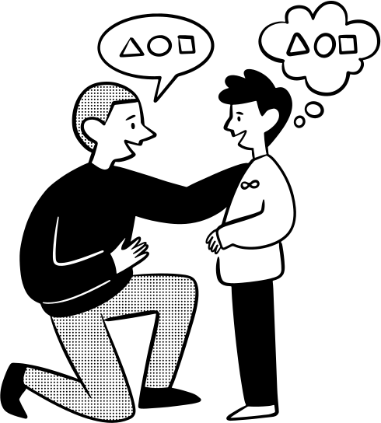


7
Activity - Let’s change the message!
Here are some examples of problematic sentences/situations used with people with ASD or ADHD
Share with the rest of the participants
Read the sentences carefully and identify where the difficulty lies.
Sharing and discussion. Extend to examples of good practice based on experience.
Propose a more respectful alternative, taking into account the characteristics of both disorders.
Questions & Answers
Notes:
‹#›

Slide 15
7
Material - Problematic sentences/situations
‘Hurry up, you should know how this goes!’
‘Don't you understand what I just told you?
Do it like everyone else, it's easy.’
‘Doesn't that seem obvious to you?’
‘Focus now!’
‘You're always interrupting.’
‘Aren't you paying attention again?’
‘Just do it, it's not that hard.’
‘Why are you acting weird?’
‘I explained that already, pay attention.’
‘Don't move around so much, you're disturbing the others.’
‘Hurry up or we'll leave without you.’
‘Stop being so dramatic.’
‘Why is it so hard for you to make friends?’
‘You have to behave like the others.’
‘I don't understand why you don't like this place.’
Notes:
‹#›

Slide 16


7
Quiz- Test your knowledge and reflect on what you've learned in this module with this short quiz.
Notes:
‹#›

Slide 17

7
Quiz- What barrier might a young person with ADHD experience at a political meeting?
A. Too much clarity of information
B. Slow and unhurried pace of meeting
C. Difficulty in maintaining sustained attention
D. Too much structured participation
Notes:
‹#›

Slide 18

7
Quiz- What barrier might a young person with ADHD experience at a political meeting?
A. Too much clarity of information
B. Slow and unhurried pace of meeting
C. Difficulty in maintaining sustained attention
D. Too much structured participation
Notes:
‹#›

Slide 19
7
Quiz- Name a useful strategy for facilitating the participation of a young person with autism
A. Changing the venue without
prior notice
B. Use metaphors and double meanings.
C. Explaining clearly what is to be done and showing it with images
D. Holding conversations in large
Notes:
‹#›

Slide 20
7
Quiz- Name a useful strategy for facilitating the participation of a young person with autism
A. Changing the venue without
prior notice
B. Use metaphors and double meanings.
C. Explaining clearly what is to be done and showing it with images
D. Holding conversations in large
Notes:
‹#›

Slide 21
7
Quiz- Which alternative sentence is most inclusive for someone with ASD or ADHD?
A. ‘Concentrate, please!’
B. It is easy!
C. Do you need more steps?’
D. I have explained it before
Notes:
‹#›

Slide 22
7
Quiz- Which alternative sentence is most inclusive for someone with ASD or ADHD?
A. ‘Concentrate, please!’
B. It is easy!
C. Do you need more steps?’
D. I have explained it before
Notes:
‹#›

Slide 23
7
Quiz- What is one possible effect of using abstract language in youth participation spaces with people with ASD?
B. It increases the creativity of the group
A. It makes it easier for everyone to
understand better
C. It can lead to confusion and exclusion
D. Favours spontaneity
Notes:
‹#›

Slide 24
7
Quiz- What is one possible effect of using abstract language in youth participation spaces with people with ASD?
B. It increases the creativity of the group
A. It makes it easier for everyone to
understand better
C. It can lead to confusion and exclusion
D. Favours spontaneity
Notes:
‹#›

Slide 25
7
Quiz- What represents good practice in cognitive accessibility?
B. Speak quickly so that their attention is not lost
A. Include visuals and outlines along
with the written text.
C. Using technical language to sound more professional
D. Presenting all information without filtering it to be transparent
Notes:
‹#›

Slide 26
7
Quiz- What represents good practice in cognitive accessibility?
B. Speak quickly so that their attention is not lost
A. Include visuals and outlines along
with the written text.
C. Using technical language to sound more professional
D. Presenting all information without filtering it to be transparent
Notes:
‹#›

Slide 27

7
Conclusion
Inclusion is not only physical accessibility, but also cognitive, emotional and communicative accessibility.
People with ASD and ADHD have different ways of perceiving, processing and responding to the environment. Understanding their specific characteristics is key to fostering their real participation.
It works:
Use clear, concrete and structured language
Support communication with visual or written elements
Anticipate changes, give step-by-step instructions and allow pauses
Promote an environment without sensory overload.
Notes:
‹#›

Slide 28







Funded by the European Union. Views and opinions expressed are however those of the author(s) only and do not necessarily reflect those of the European Union or European Education and Culture Executive Agency (EACEA). Neither the European Union nor the granting authority can be held responsible for them.

