Slide 1




Capacity Building Program for Youth Workers
Media Literacy & Critical Thinking for Political Participation
Developed by: Polska Rada Organizacji Młodzieżowych PROM

Slide 2
Learning Outcomes
After completing this module, you will have gained the following knowledge, skills and attitudes.
L01.
L02.
L03.
Understand how media shapes political beliefs, especially for youth with disabilities.
Identify misinformation and bias in political content.
Apply critical thinking tools to support informed youth participation.

Slide 3


Introduction
What is Critical Thinking
Critical thinking is the ability to analyse information objectively, evaluate different perspectives, and make reasoned judgments. It involves asking questions, checking facts, and reflecting on one's own assumptions to better understand complex issues—especially important in political and media contexts.
Notes:
‹#›

Slide 4

Introduction
How to implement Critical Thinking: The 5 Ws Method.
It is a simple technique that encourages young people to ask key questions when they encounter any piece of information - especially in news, social media, or political messages.
Who created this message?
What is being said (and what’s missing)?
Where is this information from?
When was it produced or shared?
Why was it created—what’s the purpose?
The 5 Ws method helps young people slow down, think critically, and analyze information, rather than just accept it. It’s a simple but powerful tool to build Media Literacy and support Critical Thinking for active, informed participation in society.
Notes:
‹#›

Slide 5
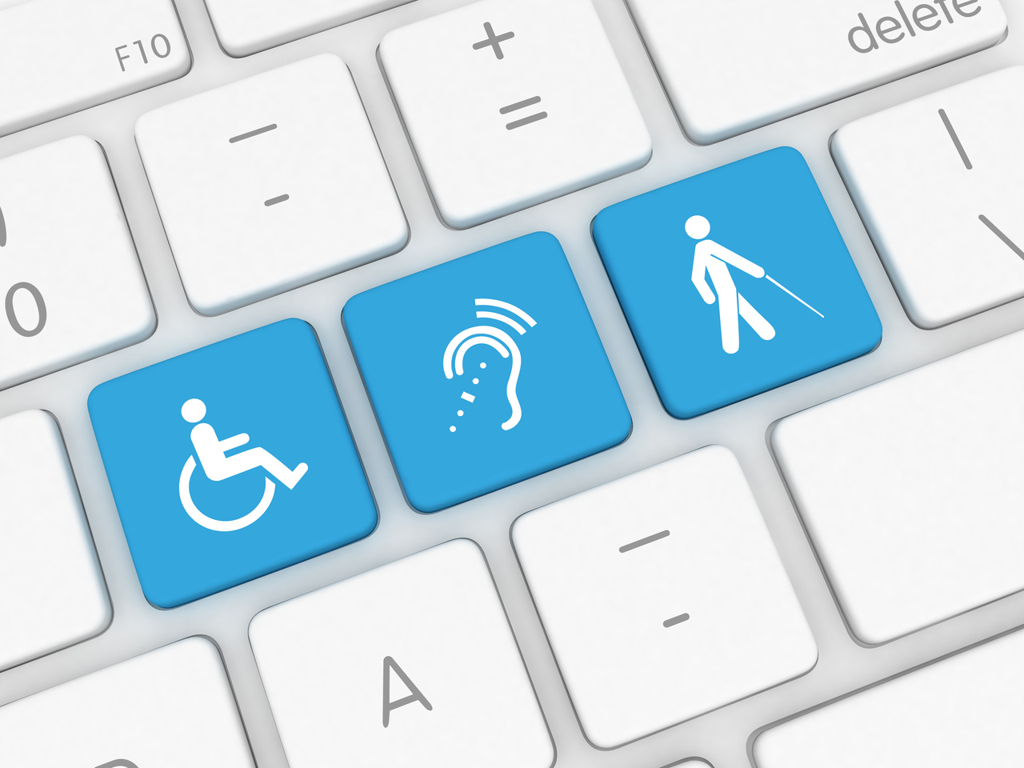
Media Literacy & Critical Thinking
Misinformation often erases or misrepresents disability perspectives in policy debates.
Media powerfully shapes political views, especially for youth with disabilities who frequently engage with online civic content. While 78% encounter political information digitally, they're also more vulnerable to misinformation and biased narratives about disability policies. Teaching media literacy helps them recognize bias, reject false claims, and advocate effectively—turning media consumption into meaningful political participation.
Notes:
‹#›

Slide 6

Key Concepts
Background information
Media Influence
Media plays a powerful role in determining which political and social issues receive public attention. By choosing what to cover - and what to ignore - news outlets shape perceptions of importance. For disability issues, this often means critical topics like accessibility rights or inclusive policies get minimal coverage unless framed as controversial or costly. For example, a news outlet might extensively report on healthcare budget debates while consistently excluding perspectives from disability advocates, creating an imbalanced public narrative.
Media serves as a primary gateway to political information, shaping how citizens—especially young people with disabilities—understand and engage with civic issues. Its power lies not just in reporting events, but in selecting which topics are highlighted (agenda-setting), how they are presented (framing), and who gets heard (echo chambers).
Framing
Echo Chambers
The way media presents issues significantly influences how audiences interpret them. Identical policies can be framed positively or negatively to evoke different reactions. When covering disability-related legislation, negative framing might emphasize costs ("Budget Drain: New Disability Law Costs Millions") while positive framing highlights benefits ("Landmark Law Grants Independence to Disabled Youth"). These framing choices can determine whether the public views disability rights as burdensome or as necessary steps toward equality.
Social media platforms use algorithms that show users content aligning with their existing views, creating informational bubbles. For disability advocacy, this means many users never encounter perspectives from disabled activists or see balanced coverage of disability issues. These echo chambers can reinforce stereotypes and make it harder for inclusive policies to gain mainstream support, as opposing viewpoints get systematically filtered out of users' feeds.

Slide 7

Media Framing in Action
How to Apply This in Practice: A Step-by-Step Guide for Youth Workers
1. Present Two Contrasting Headlines
Show two headlines reporting the same event (as below).
Negative frame: "Taxpayers to Foot $20M Bill for New Disability Accommodations"
Positive frame: "Historic $20M Investment Will Make Schools Accessible for All Students"
Ask participants to:
Identify emotionally charged words
Guess the likely source (tabloid? advocacy group?)
Predict how readers with different political leanings might respond
Notes:
‹#›

Slide 8
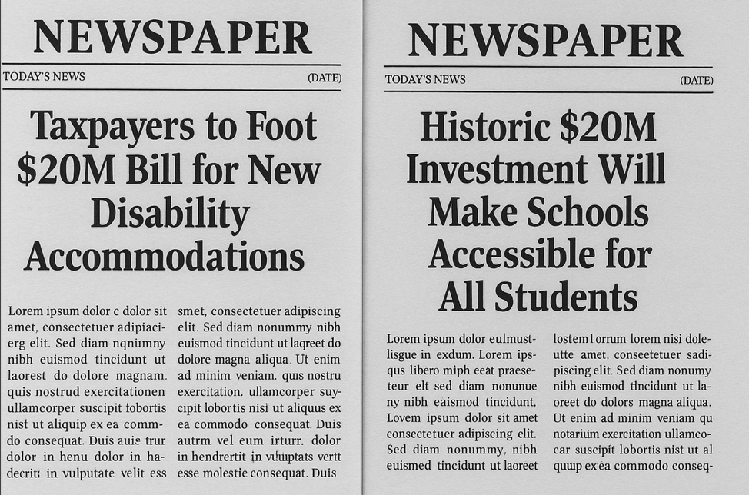
Media Framing in Action
How to Apply This in Practice: A Step-by-Step Guide for Youth Workers pt.2
2. Facilitate a Guided Discussion
Use prompt questions like:
What emotions do the headlines trigger?
Which stakeholders are centered or omitted (e.g., taxpayers vs students)?
What assumptions do each make about the audience's values?
Notes:
‹#›

Slide 9
Media Framing in Action
How to Apply This in Practice: A Step-by-Step Guide for Youth Workers pt.3
3. Deconstruction Activity
Provide short articles or headlines on other political or social issues (e.g., climate action, migration, education reform). Ask youth to:
Highlight biased wording
Reframe the headline from another perspective (positive, neutral, opposing viewpoint)
Discuss the intended and unintended impacts of each frame
Notes:
‹#›

Slide 10
Media Framing in Action
How to Apply This in Practice: A Step-by-Step Guide for Youth Workers pt.4
4. Reflection & Real-World Connection
Ask:
How might framing influence voting, civic engagement, or public outrage?
Where do we see framing used in youth-targeted media?
How can we fact-check and seek neutral or multiple perspectives?
Notes:
‹#›

Slide 11

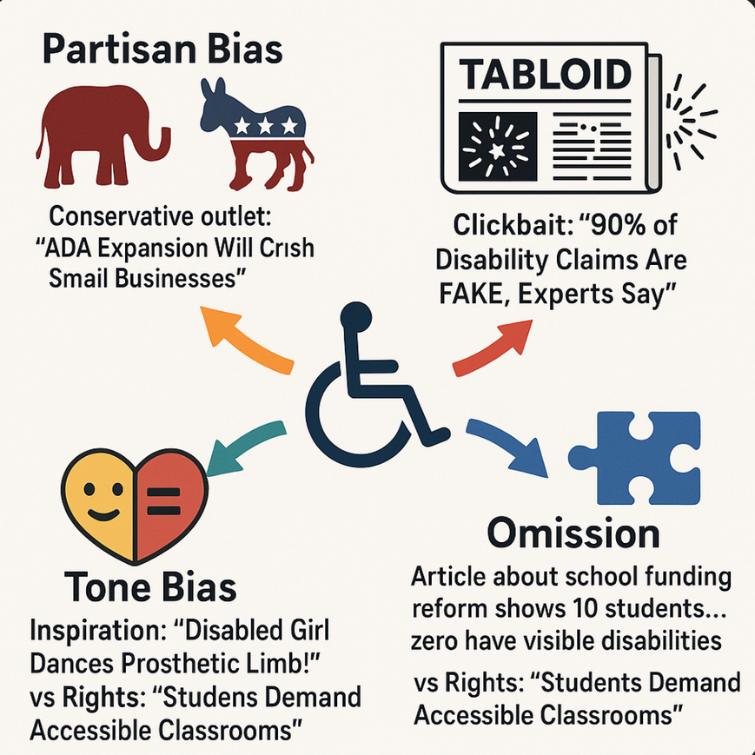

Recognizing Media Bias: Types and Impacts
Watch the video:
TED-Ed "How to Choose Your News" (4:48)
The video teaches critical analysis skills perfect for discussing disability representation.

Slide 12

7
Fake News Detector Challenge
Participants practice identifying red flags in disability-related misinformation using a 3-step verification method.
Materials Needed:
3 printed examples of viral claims about disability policies (1 true, 2 false), Fact-checking tools cheat sheet (Snopes, ADA National Network), Timer
Duration: 15 minutes
Steps:
Small groups analyse each claim using the "S.A.M." method:
Source (Who posted this?)
Agenda (Why might they share this?)
Money (Who profits if this spreads?)
Groups present their findings using a "Warning Sign" rating (1-5)
Debrief on how misinformation uniquely harms disability communities
Notes:
‹#›

Slide 13






7
Activity – "Headline Analysis"
Distribute two contrasting headlines about the same disability rights bill.
Discuss how each headline might influence public perception of disability issues.
Read the headlines aloud for all participants.
Share group insights with the larger cohort.
Analyse word choices, framing, and emotional tone in small groups.
Reflect on how to identify bias in real-world media.
Notes:
‹#›

Slide 14
7
What to remember?
You have explored a set of practical activities to help young people engage more critically with media and political content.
In all activities, encourage the consistent use of the 5 Ws method — asking Who, What, Where, When, and Why — to promote deeper thinking and analysis.
Create space for reflection and discussion. Critical thinking develops when young people are guided to question information, consider different perspectives, and form their own informed opinions.
Notes:
‹#›

Slide 15

Tips or Steps for Youth Workers
Prepare Clear Framing Contrasts
Begin by selecting paired headlines that present opposing narratives about identical disability policies, such as "New Disability Law Will Bankrupt States" versus "Landmark Bill Ends Transportation Barriers for Disabled Youth." Enhance visibility of bias by using color-coded text boxes (red for negative framing like "burden," green for positive terms like "opportunity"), and prioritize locally relevant examples to strengthen participant engagement through familiar contexts.
Systematically Highlight Omissions
Guide participants to detect missing perspectives by posing targeted questions like "Whose voice isn't represented here?" Illustrate how exclusions distort understanding - for instance, showing education reform articles that never mention disabled students. Provide a practical "Missing Voices" checklist (including disabled individuals, caregivers, and subject experts) as an analytical tool to help groups identify these gaps consistently.

Slide 16
Deploy Strategic Probing Questions
Move beyond surface-level analysis by asking questions that reveal underlying power structures: "Who benefits when people accept this framing?" or "How might a wheelchair user interpret this headline?" Demonstrate the questioning process by modeling with one headline first, then transition to small group practice. This scaffolds critical thinking while encouraging participants to consider both explicit messages and subtle omissions.
Implement Universal Accessibility Adaptations
Ensure full participation by preparing multiple access formats: audio clips with alt-text descriptions for visually impaired learners; Easy Read versions using symbols e.g. (💰/♿) for cognitive accessibility; emoji response cards (👍/👎) or clicker polls for nonverbal engagement; and printed transcripts with bolded key terms for deaf/hard of hearing participants. These intentional adaptations maintain analytical rigor while removing participation barriers.

Slide 17


7
Quiz- Test your knowledge and reflect on what you've learned in this module with this short quiz.
Notes:
‹#›

Slide 18

7
What is agenda-setting?
Choosing important topics
TV schedules
Meeting times
Public topics
Notes:
‹#›

Slide 19

7
What is agenda-setting?
Agenda-setting refers to how media influences what issues the public perceives as important by deciding which topics to cover prominently.
Choosing important topics
TV schedules
Meeting times
Public topics
Notes:
‹#›

Slide 20
7
Choose the best disability headline.
"Costly new law"
"Wastes millions"
"Grants independence"
“Another demand”
Notes:
‹#›

Slide 21
7
Choose the best disability headline.
This is rights-based language that frames disability policy positively, aligning with inclusive messaging. The other options use negative framing ("costly," "wastes") that perpetuates stigma.
"Costly new law"
B. xxx
"Wastes millions"
"Grants independence"
D. xxx
“Another demand”
Notes:
‹#›

Slide 22
7
Echo chambers...?
Help everyone
Add facts
Fix bias
Hide views
Notes:
‹#›

Slide 23
7
Best disability headline?
Echo chambers occur when social media algorithms show users only content that aligns with their existing views. This hides diverse perspectives (like disability advocacy content from non-disabled users).
Help everyone
Add facts
Fix bias
Hide views
Notes:
‹#›

Slide 24
7
Conclusion
This module equipped you with essential media literacy skills to support youth with disabilities in political participation. We covered:
Media’s Influence
Agenda-setting and framing shape how disability policies are perceived (e.g., "cost" vs. "rights" language).
Echo chambers hide disabled voices, limiting inclusive dialogue.
Bias & Misinformation
Identified 4 bias types (partisan, sensationalism, omission, tone) in disability coverage.
Practiced spotting red flags like missing perspectives and emotional manipulation.
Critical Thinking Tools
5Ws Method: Who, What, Where, When, Why?
S.A.M. Method: Analyze Source, Agenda, and Money behind content.
Headline Analysis: Contrasted frames to expose bias (Activity 1).
Accessible Advocacy
Adapt activities for diverse needs (audio descriptions, Easy Read, emoji responses).
Amplify disabled youth’s voices in media analysis and creation.
Notes:
‹#›

Slide 25







Funded by the European Union. Views and opinions expressed are however those of the author(s) only and do not necessarily reflect those of the European Union or European Education and Culture Executive Agency (EACEA). Neither the European Union nor the granting authority can be held responsible for them.

