Slide 1




Capacity Building Program for Youth Workers
Understanding Psychosocial Disabilities and Participation
Developed by: KMOP

Slide 2

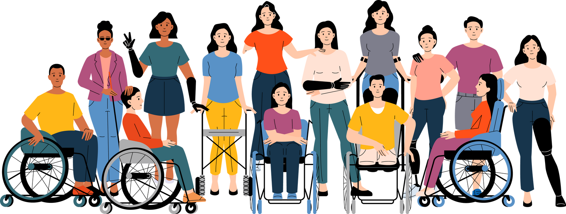
Introduction
In this module, we will explore what psychosocial disability means and how it affects young people’s daily lives, not just through mental health conditions, but through the barriers created by society.
We’ll focus on four key challenges: stigma, lack of access, low confidence, and underrepresentation and their impact on political participation.
This module is especially relevant for youth workers, as you play an important role in recognising these barriers, supporting inclusion, and empowering all young people to participate fully in community life and decision-making.
Notes:
‹#›

Slide 3
Learning Outcomes
After completing this module, you will have gained the following knowledge, skills and attitudes.
Understand psychosocial disabilities , common barriers and impact in political participation
L01.
L02.
L03.
Define psychosocial disabilities, recognize the diversity of experiences through personal stories or multimedia content, and reflect on how these conditions affect daily life, especially in the context of social and political engagement.
You will be able to explain the unique challenges faced by individuals with psychosocial disabilities in political processes, including voting, advocacy, community involvement, and leadership roles.
You will be able to identify key barriers such as stigma, lack of accessible environments, low confidence, and limited representation.

Slide 4
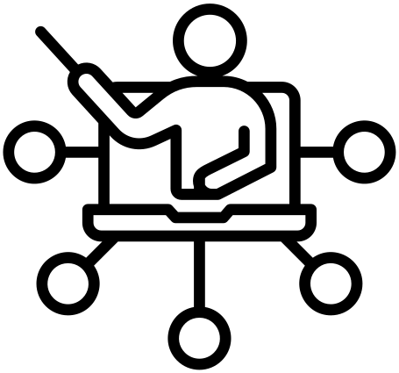
Key Concepts
Psychosocial disability
Stigma
Negative stereotypes and discrimination that create social exclusion and discourage participation in public life.
A form of disability that arises from the interaction between mental health conditions and social barriers that limit full participation in society.
Political participation
Lived experiences
Involvement in civic and democratic life, including voting, activism, public discourse, and decision-making processes.
Personal stories and insights from individuals with psychosocial disabilities, which highlight the real-world impact of stigma, exclusion, and resilience.

Slide 5
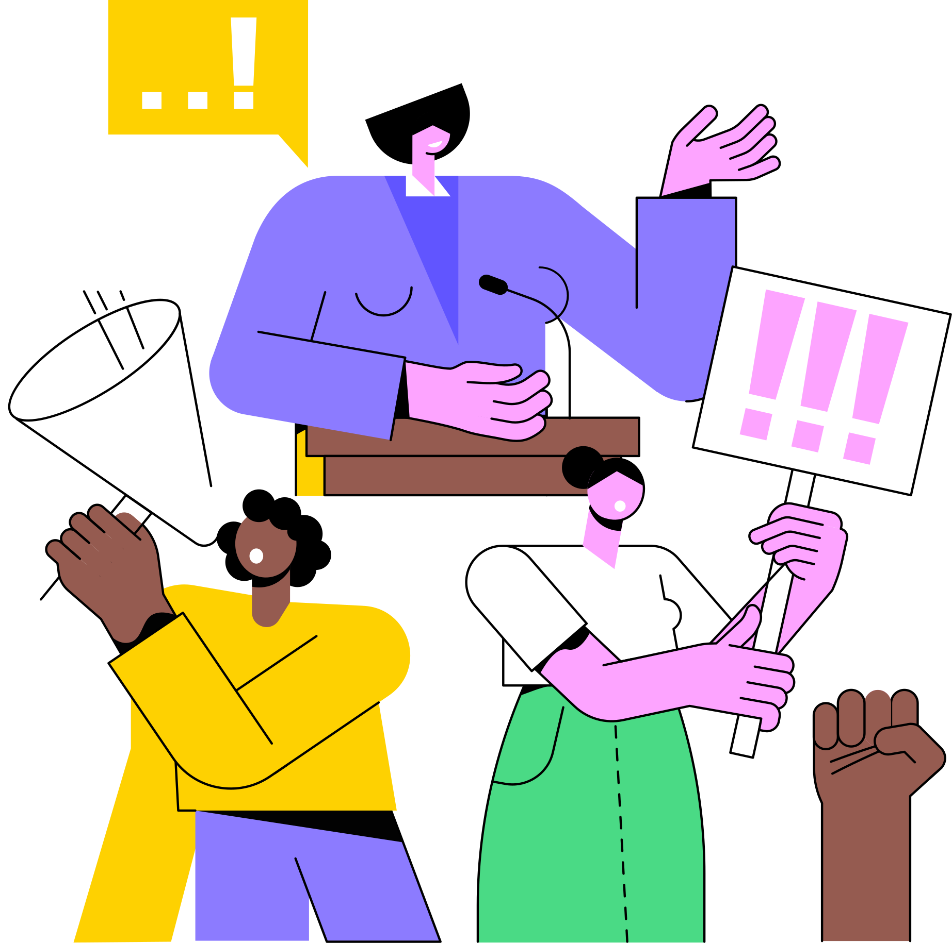
What is psychosocial disability?
According to NSW health (2020), psychosocial disability doesn’t refer to a mental health diagnosis itself, but rather to how a mental health condition affects a person’s ability to function and the obstacles they encounter in daily life. It occurs when societal barriers prevent someone with a mental health condition from having the same opportunities and participation as others.
For example, someone with anxiety may manage it well with support and experience no major limitations. However, another person with the same condition might face discrimination, lack of support, or stigma at work or in public, leading to restricted participation. In this case, the interaction between the condition and the environment creates a psychosocial disability.
Notes:
‹#›

Slide 6
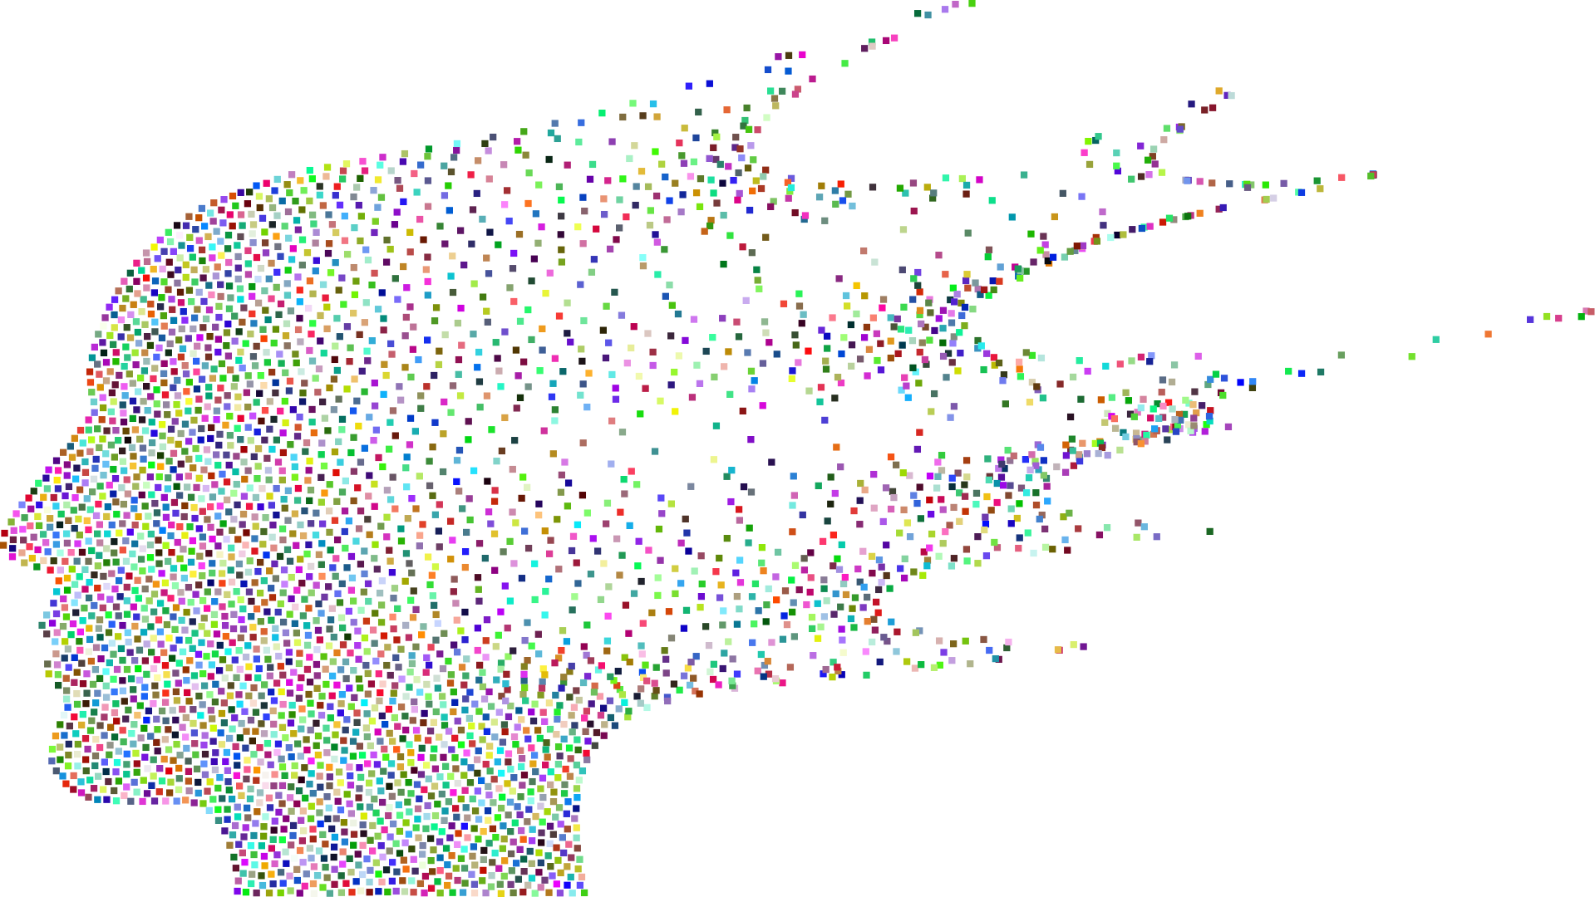
Video- UNCRPD: What is a psychosocial model of disability?
https://www.youtube.com/watch?v=NCIDkMbJslA&t=178s

Slide 7
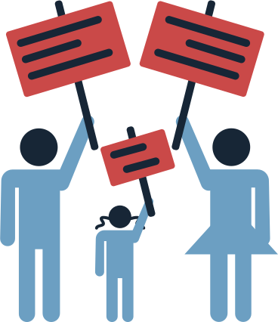
How do psychosocial disabilities impact political participation?
Key Impact Areas
Legal and administrative barriers:
Many countries maintain legal restrictions that limit voting rights for persons with psychosocial disabilities, especially those under guardianship or in institutional care.
Complex voter registration processes may be particularly challenging to navigate.
Identification requirements can pose additional obstacles.
Physical and environmental barriers:
Polling stations may lack proper accommodations for those with anxiety disorders or other psychosocial disabilities.
Long lines and crowded spaces can trigger symptoms for many individuals.
Transportation difficulties can limit access to political events and voting locations.
Notes:
‹#›

Slide 8
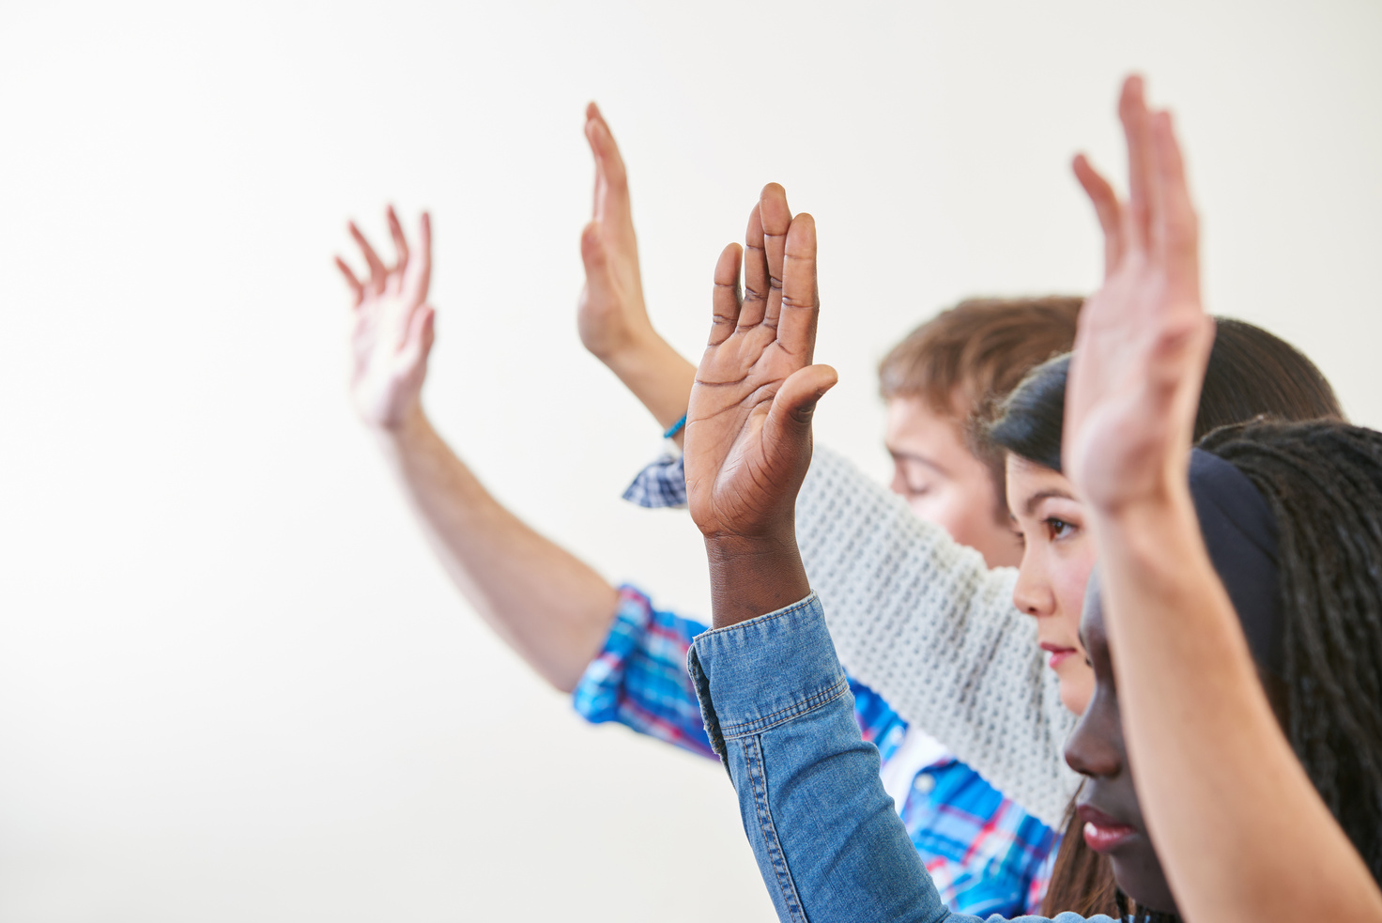
How do psychosocial disabilities impact political participation?
Key Impact Areas
Social and attitudinal barriers:
Stigma and discrimination may discourage political participation.
Social isolation can reduce exposure to political information and mobilization networks.
Interactions with officials or other voters may be difficult due to social anxiety.
Individual challenges:
Symptoms such as low motivation or difficulty in concentrating, can interfere with political activities.
Medication side effects may impact energy levels or cognitive functioning.
Notes:
‹#›

Slide 9

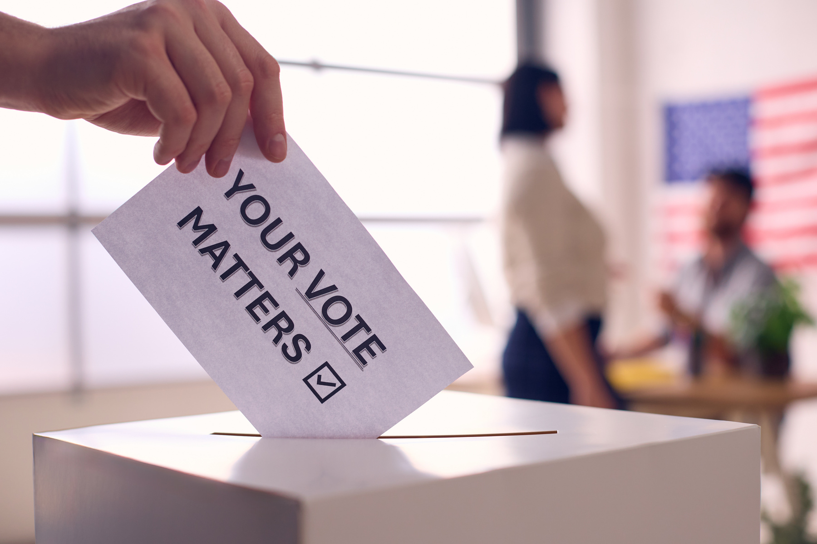
Case Study: María Fernanda Castro Maya – Disability rights activist
María Fernanda Castro Maya, a Mexican disability rights activist with an intellectual disability, has been a prominent advocate for the political inclusion of persons with disabilities.
She proposed an amendment to the Mexico City Civil Code to abolish the requirement for adults with disabilities to have a legal guardian, aiming to enhance their autonomy.
María Fernanda has actively engaged with political parties, urging them to consider intellectual disabilities in their platforms and to promote linguistic accessibility in political documents.
Click here to learn more about María Fernanda Castro Maya.

Slide 10

Common Barriers: Stigma, Access, Confidence, and Representation
According to Kleintjes et al. (2013) and UNPD (2021) people with psychosocial disabilities face the following barriers:
Stigma & Discrimination: Persistent negative attitudes and misconceptions lead to exclusion, bullying, and internalized shame. This reduces self-worth and discourages social participation.
Lack of access: Inaccessible mental health services, education, and public spaces hinder full participation. Youth often face financial, geographic, or systemic barriers to support.
Low confidence & self-esteem: A history of disempowerment, institutionalization, or exclusion can erode self-confidence, limiting engagement in community or leadership roles.
Underrepresentation: Young people with psychosocial disabilities are rarely included in decision-making processes. Their voices are often overlooked in youth, disability, and policy spaces.
Notes:
‹#›

Slide 11
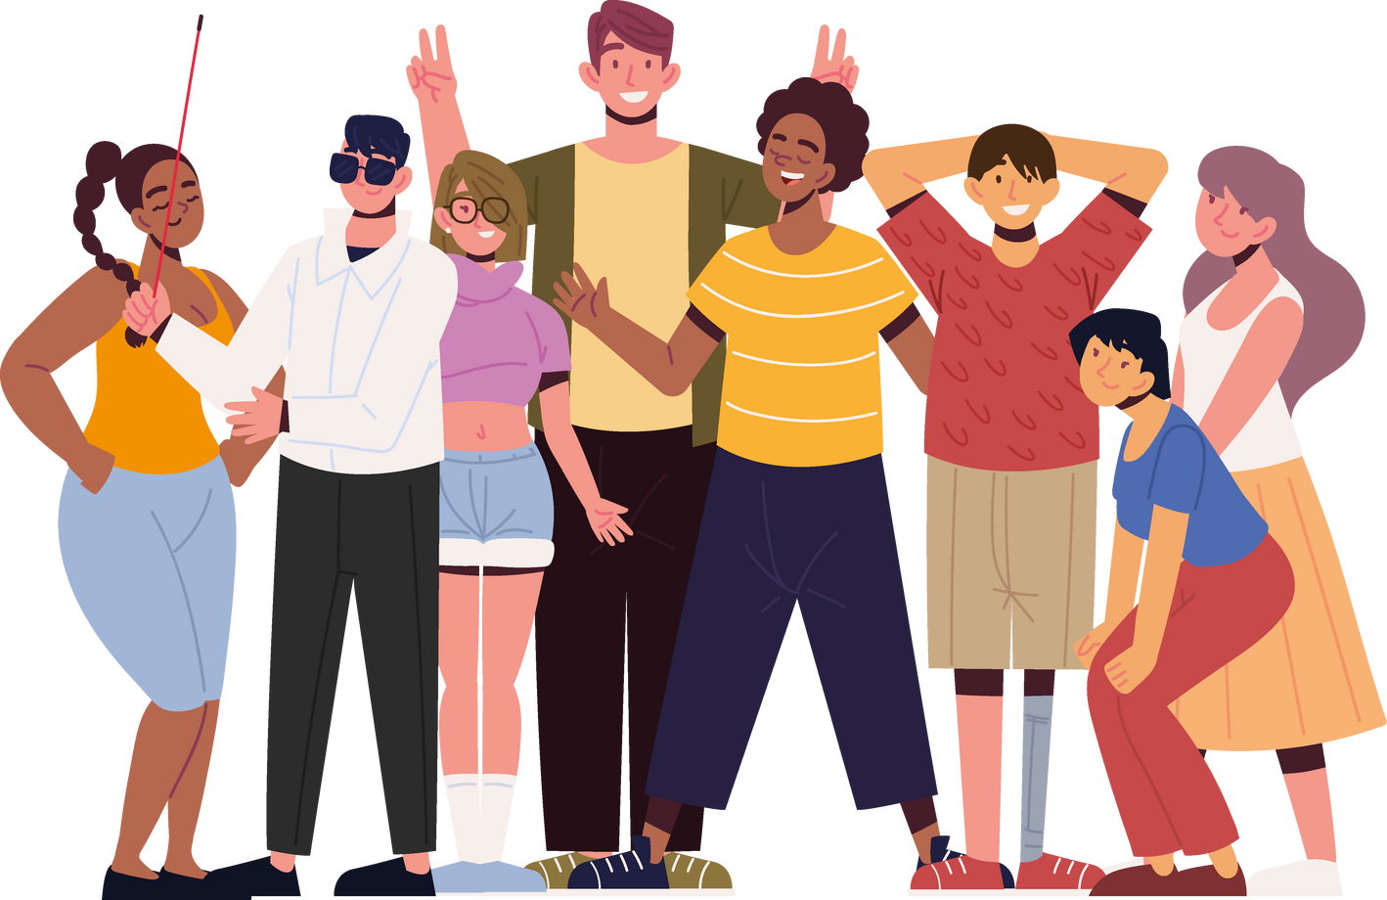
Video- Social Model of Disability
https://www.youtube.com/watch?v=24KE__OCKMw

Slide 12

Tips for Youth Workers
Working with young people who have psychosocial disabilities requires thoughtful approaches to encourage political participation. Here are some practical, feasible tips for youth workers:
Tip 1 -Create a step-by-step participation ladder
Tip 3 - Connect political participation to personal interests
Begin with small, manageable activities like watching a short political video together or discussing a single issue that matters to the young person. Gradually increase complexity toward activities like attending a small community meeting, then perhaps contacting a representative about an issue they care about.
Identify issues the young person already cares about—whether it's music, gaming, sports, or local parks—and show how these connect to political decisions. Help them discover advocacy groups or local initiatives related to their interests where they can start engaging.
Tip 2 - Use role-playing to build confidence
Tip 4 - Develop a personalised accommodation plan
Set up informal practice sessions for potentially stressful situations like registering to vote or speaking at a community meeting. Take turns playing different roles (voter, election official, etc.) in a supportive environment. Provide constructive feedback focused primarily on what went well, helping build confidence through simulation before real-world experiences.
Work together to create a simple written plan identifying their specific challenges (like crowds, complicated forms, or social anxiety) and corresponding solutions. Include helpful accommodations like bringing a support person to events, using noise-canceling headphones, or requesting early voting options.

Slide 13
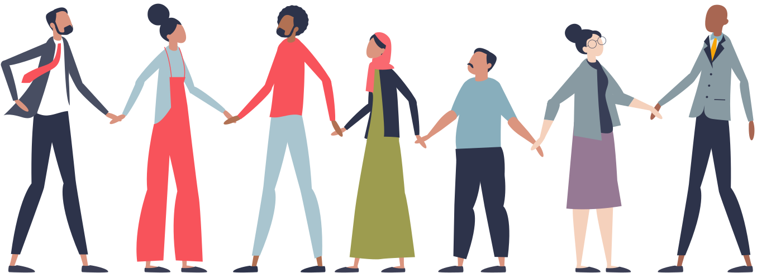
7
Activity - “Step into my shoes”
Goal:
This activity will help you understand the barriers (stigma, access, confidence, representation) and how they affect political participation of young people with psychosocial disabilities.
Duration: 30 minutes
Key Learning Outcomes:
Experience how exclusion operates.
Understand why political participation is about more than voting.
Reflect on how to reduce barriers in their own youth work.
Notes:
‹#›

Slide 14



7
Activity - “Step into my shoes”
Intro & Setup (5 minutes)- Briefly introduce the activity: “We’re going to experience how different people face unequal opportunities to participate in society and politics.”
Hand out role cards (prepared in advance) with short character profiles (e.g., "19-year-old with bipolar disorder in a rural town", "22-year-old non-disabled law student").
Debrief & Discussion (15 minutes)
Ask reflection questions:
“How did it feel to take more or fewer steps?”
“What were the main barriers your character faced?”
“What does this say about real-life political participation for people with psychosocial disabilities?”
Simulation: Step Forward Game (10 minutes)
Mark a line on the floor (starting point). Then read ~8 statements aloud. Participants step forward if the statement applies to their role.
Example statements:
“I have access to reliable mental health services.”
“People in my community take my opinions seriously.”
“I can run for youth leadership positions.”
Notes:
‹#›

Slide 15

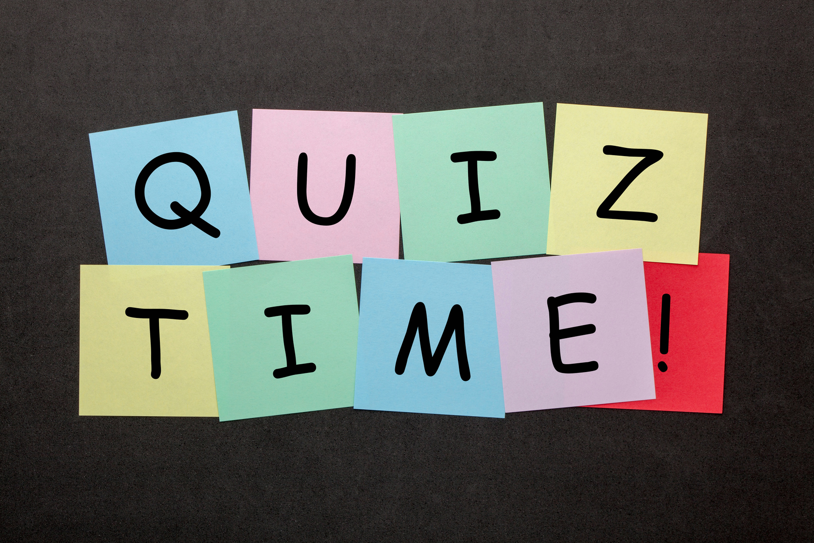
7
Quiz- Test your knowledge and reflect on what you've learned in this module with this short quiz.
Notes:
‹#›

Slide 16

7
Quiz- 1. Which of the following best defines psychosocial disability?
A. A diagnosis of a mental health condition
B. The impact of mental health conditions combined with societal barriers on a person’s ability to participate fully
C. Any disability caused by a psychological trauma
D. A temporary emotional reaction to stress
Notes:
‹#›

Slide 17

7
Quiz- Understanding Psychosocial Disability and Barriers to Participation
A. A diagnosis of a mental health condition
B. The impact of mental health conditions combined with societal barriers on a person’s ability to participate fully
C. Any disability caused by a psychological trauma
D. A temporary emotional reaction to stress
Notes:
‹#›

Slide 18
7
Quiz- 2. Why is stigma considered a major barrier for youth with psychosocial disabilities?
A. It increases their dependence on others
B. It leads to exclusion, internalized shame, and reduced social participation
C. It causes physical symptoms that prevent education
D. It prevents them from getting a formal diagnosis
Notes:
‹#›

Slide 19
Quiz- 2. Why is stigma considered a major barrier for youth with psychosocial disabilities?
7
A. It increases their dependence on others
B. It leads to exclusion, internalized shame, and reduced social participation
C. It causes physical symptoms that prevent education
D. It prevents them from getting a formal diagnosis
Notes:
‹#›

Slide 20
7
Quiz- 3. How does underrepresentation affect young people with psychosocial disabilities?
A. It increases their access to mental health services
B. It improves their chances of leadership roles
C. It limits their inclusion in decision-making and policy spaces
D. It only impacts adults, not youth
Notes:
‹#›

Slide 21
7
Quiz- 3. How does underrepresentation affect young people with psychosocial disabilities?
A. It increases their access to mental health services
B. It improves their chances of leadership roles
C. It limits their inclusion in decision-making and policy spaces
D.It only impacts adults, not youth
Notes:
‹#›

Slide 22
7
Quiz- 4. What is a possible long-term effect of disempowerment and exclusion on youth with psychosocial disabilities?
A. Enhanced political engagement
B. Improved resilience and coping
D. Low confidence and reduced participation in community roles
C. Better access to healthcare
Notes:
‹#›

Slide 23
Quiz- 4. What is a possible long-term effect of disempowerment and exclusion on youth with psychosocial disabilities?
7
A. Enhanced political engagement
B. Improved resilience and coping
C. Better access to healthcare
D. Low confidence and reduced participation in community roles
Notes:
‹#›

Slide 24
7
References
Kleintjes, S., Lund, C., & Swartz, L. (2013). Barriers to the participation of people with psychosocial disability in mental health policy development in South Africa: a qualitative study of perspectives of policy makers, professionals, religious leaders and academics. BMC International Health and Human Rights, 13(1). https://doi.org/10.1186/1472-698x-13-17
NSW (2020) What is psychosocial disability? https://www.health.nsw.gov.au/mentalhealth/psychosocial/foundations/Pages/psychosocial-whatis.aspx
UNDP (2021) Political Participation of Persons with Intellectual or Psychosocial Disabilities. (n.d.). UNDP. https://www.undp.org/publications/political-participation-persons-intellectual-or-psychosocial-disabilities
Notes:
‹#›

Slide 25







Funded by the European Union. Views and opinions expressed are however those of the author(s) only and do not necessarily reflect those of the European Union or European Education and Culture Executive Agency (EACEA). Neither the European Union nor the granting authority can be held responsible for them.

