Slide 1


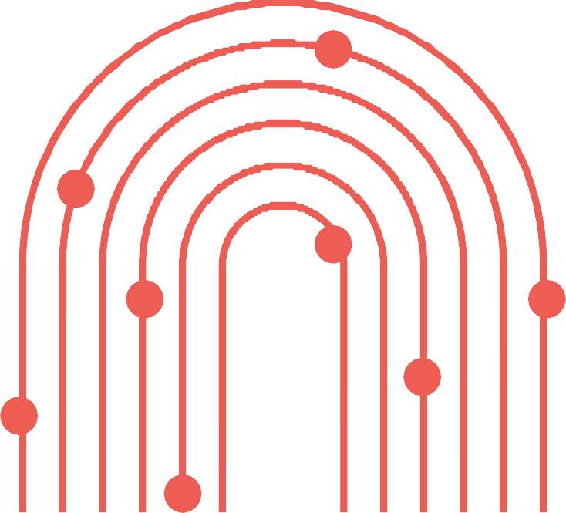

Capacity Building Program for Youth Workers
Creating inclusive political environments
Developed by: Open Group

Slide 2

LearningOutcomes
Aftercompletingthismodule,youwillhavegainedthefollowingknowledge,skillsand attitudes.
L01. HowToMake PoliticalSpaces MoreAccessible
L02.WhatShouldPolitical OrganizationsDotoEngage withYouthwithDisabilities
L03.HowTo Advocatefor SystemicChange
You’ll learn advocacy skills to
You will learn how to make political spaces—such as meetings, debates, and voting processes—more inclusive and accessible for persons with disabilities.
You’ll learn how you can encourage political organizations to actively involve young people with disabilities—by
raise
awareness, build strong support networks, and push for changes that make political spaces more inclusive and fair for everyone.
creating welcoming spaces, offering real opportunities for participation, and listening to their needs.
This includes addressing physical, informational, and attitudinal barriers to participation.

Slide 3
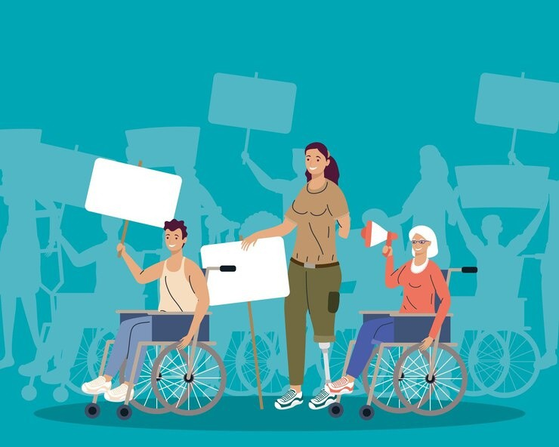
Introduction
Inclusive political environments ensure that everyone, including youth with disabilities, has equal access to participate in democracy.
In 2023, 27% of the EU population over the age of 16 had some form of disability. According to Eurostat estimates, that equals about 101 million people
— or one in four adults in the EU. Despite this, many people with disabilities still face barriers that limit their full participation in political life, including in Italy.
This module will provide you with practical tools to create and support accessible political spaces. By the end, you'll be ready to make a real difference!

Slide 4
Key Concepts
Political inclusivity
Political inclusivity means individuals, regardless of backgrounds, have equal
Physical Accessibility
Physical accessibility involves removing obstacles that limit mobility, such as stairs without ramps or elevators, narrow doorways, and cramped spaces. It also means providing solutions like ramps, elevators, and wider doors to enable easy access and movement.
Digital Accessibility
Digital accessibility ensures websites, apps, and
ensuring that all their abilities or opportunities to
and
participate fully in political processes decision-making.
It involves removing barriers—whether physical, social, or institutional—that prevent people from engaging in political activities such as voting, attending meetings, or participating in debates.
online platforms are easy to use for all,
or
including cognitive readers,
people with visual, hearing,
disabilities. Features like screen
captions, keyboard navigation, and
simple layouts help make digital political spaces inclusive.

Slide 5
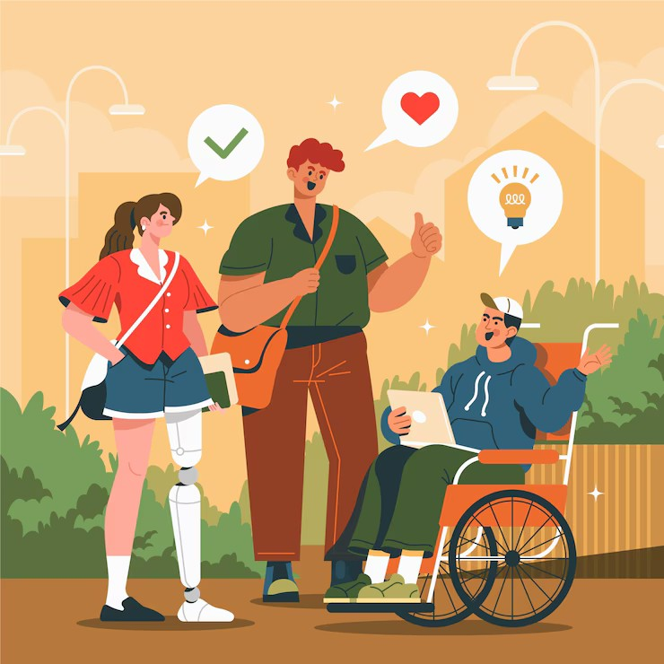
Inclusion in Action
Inclusion in action means creating political spaces where people with disabilities can participate fully, not just in words but through real, practical measures. This involves removing physical barriers like inaccessible stairs and narrow doors, ensuring digital content is usable with assistive technologies, and addressing sensory barriers by
providing sign language interpretation, subtitles, and audio descriptions.
True inclusion also means guaranteeing representation and practicing active listening—engaging people with disabilities in meaningful dialogue and using their input to shape policies and decisions.
Inclusion is not a symbolic gesture but an ongoing effort to make participation accessible, respectful, and impactful for everyone!

Slide 6

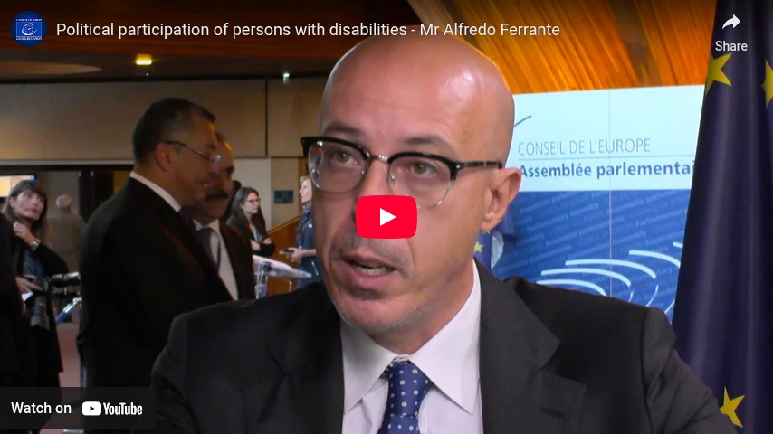
Political participation of persons with disabilities
Duration: 3.07

Slide 7
Audio Description Is Not Extra
Audio description (AD) transforms visual content into spoken words. It narrates scene changes, characters’ actions, and on-screen text — making media accessible for blind and partially sighted people. But its impact goes beyond vision loss.
🗣 AD also helps people with cognitive disabilities by providing structured, verbal information that supports understanding of complex visual content.
💡 To understand its value: try watching a TV show with your eyes closed. Can you follow the story? That’s the gap AD fills.
Reference: Describing audiodescription (2016). https://www.euroblind.org/newsletter/2016/july-august/en/describing-audiodescription

Slide 8
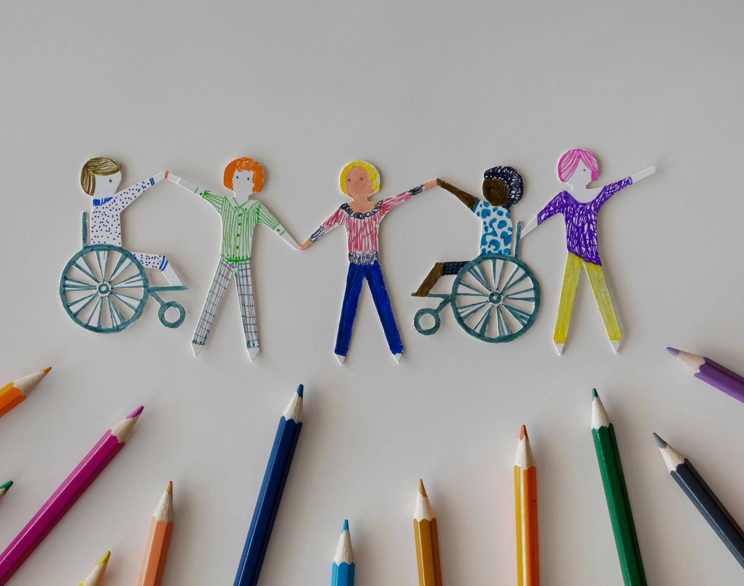
From Accommodation to Co-Creation
Traditionally, inclusion in politics has been framed as a matter of “accommodating” people with disabilities — adjusting structures built without them in mind. But real progress demands a shift toward co-creation: designing political spaces, materials, and decisions with disabled people from the beginning. This approach values disabled knowledge as essential, not exceptional.
This idea aligns with the “nothing about us without us” principle at the heart of disability justice movements and the UN CRPD’s Article 4 on inclusive policy development.

Slide 9
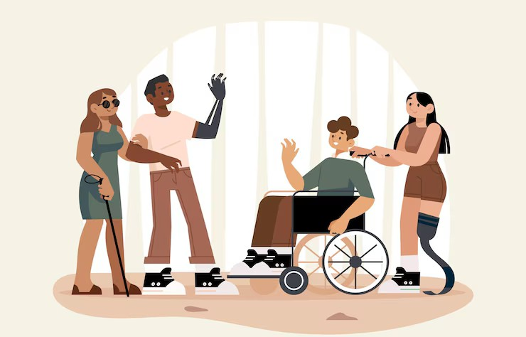
Intersectionality Matters
Inclusion must consider the multiple identities that people with disabilities hold — including gender, ethnicity, migration background, sexual orientation, or economic status. These intersecting factors shape how they experience exclusion, and must be addressed to avoid one-size-fits-all inclusion strategies.
For example, a young woman with a cognitive disability living in a remote area may face:
Inaccessible transport to polling stations Few or no Easy-to-Read materials
Stereotypes that question her ability to understand or contribute to political matters

Slide 10
Check out this toolkit (easy-to-read version)!
Political Participation of Persons with Intellectual or Psychosocial Disabilities, UNDP, 2021
https://www.undp.org/publications/political- participation-persons-intellectual-or-psychosocial- disabilities

Slide 11

Activity #1 - Simplifying Political Language
7
Objective: To help participants understand how complex political language can create barriers for people with disabilities and to practice making political content more accessible and inclusive.
Materials needed: A fake political program (5 complex points), printed copies or digital slides of the program, flipchart or whiteboard, markers or digital notes.
Duration: 15 minutes

Slide 12
Activity #1 - Simplifying Political Language
7
Present the complex text
Show participants a fake political program with 5 points written in complex, inaccessible language.
Group Division
Split participants into small groups (3-5 people each) and hand out the program text.
Identify Barriers
Each group identifies difficult words, phrases, or concepts that could create barriers for people with disabilities.
Simplify the Content
Groups rewrite the program using simple, inclusive language to make it more accessible.
clear, and
Share Results
Groups quickly present their simplified version and explain their main changes.
Final Reflection
Brief group discussion on why accessible essential for inclusive political participation.
language is

Slide 13
Activity #2 - Creating an Accessibility Checklist for Political Events
7
Objective: To encourage participants to reflect on barriers faced by people with disabilities and collaboratively create a practical checklist for organizing accessible political events.
Materials needed: Blank sheets or digital documents to create the checklist; markers, pens, or digital editing tools; flipchart or shared screen for final discussion
Duration: 15 minutes

Slide 14
Activity #2 - Creating an Accessibility Checklist for Political Events
7
Brainstom Barriers
In small groups, participants brainstorm barriers that people with physical and cognitive disabilities might face when attending political events.
Group Division
Participants work in groups of 3-5 to organize their ideas into categories (physical accessibility, digital accessibility, etc)
Checklist Creation
Each group creates a simple checklist of actions and good practices to ensure political events are accessible to all.
Present Group Checklists
Groups share their checklists with the rest of the participants, explaining their priorities and solutions.
Collective Version
Facilitator gathers all inputs to create a shared version of the accessibility checklist for political events.
Final Reflection
Short discussion on why accessibility should always be planned from the beginning in political activities and how a checklist helps prevent exclusion.

Slide 15

Tips or Steps for Youth Workers
Tip 1 - Use an Accessibility Checklist
Always plan events and political activities with a simple checklist to ensure physical, digital, and communication accessibility. It’s a practical tool for inclusive participation and better advocacy impact.
Tip 2 - Communicate with Inclusive Language
Use clear, simple language, Easy-to-Read formats, subtitles for videos, and Augmentative and Alternative Communication (AAC) when needed. Accessible communication allows everyone to follow political discussions and be part of advocacy efforts.

Slide 16

Tips or Steps for Youth Workers
Tip 3 - Provide Personalized Support
Involve support figures who act as ‘political mediators’, helping people with disabilities navigate political spaces. This enables personal empowerment and active participation, beyond just advocacy.
Tip 4 - Create a Safe and Stigma-free Space
Foster a welcoming environment where participants feel safe to express themselves without fear of judgment. This is essential for meaningful engagement, collective dialogue, and inclusive decision-making.

Slide 17

Now, let’s have fun!
7

Slide 18
Question 1: Which option ensures both physical and communication accessibility at a political event?
7
A. A ramp
B. Easy-to-Read and sign language
C. Ramps, restrooms, Easy-to-Read, subtitles
D. Online post

Slide 19
Question 1: Which option ensures both physical and communication accessibility at a political event?
7
A. A ramp
B. Easy-to-Read and sign language
C. Ramps, restrooms, Easy-to-Read, subtitles
D. Online post

Slide 20
Question 2: Using Easy-to-Read formats and subtitles in political communication helps
only people with cognitive disabilities.
7
A. True
B. False

Slide 21
Question 2: Using Easy-to-Read formats and subtitles in political communication helps
only people with cognitive disabilities.
7
A. True
B. False
Inclusive communication benefits many people, including non- native speakers and people with hearing impairments

Slide 22
Question 3: What role does personalized support, like a political mediator, play for youth with disabilities in political spaces?
7

Slide 23
7
Answer 3: It helps remove barriers by explaining political processes, providing guidance, and ensuring they can participate fully and confidently.

Slide 24
Question 4: Why create a stigma-free, safe space?
7
A. To encourage honest sharing
B. To make events easier to organize
C. To reduce costs
D. To follow rules

Slide 25
Question 4: Why create a stigma-free, safe space?
7
A. To encourage honest sharing
B. To make events easier to organize
C. To reduce costs
D. To follow rules

Slide 26
Conclusion - summary
7
This module has explored how to create truly inclusive political environments by addressing physical, sensory, and digital barriers that limit participation.
We highlighted the importance of active listening and genuine representation to ensure all voices, especially those of youth with disabilities, are heard.
Practical tools such as accessibility checklists, inclusive communication, personalized support, and safe, stigma-free spaces empower youth workers to foster meaningful engagement.
By applying these strategies, you can advocate effectively and help build political spaces where everyone can participate fully and equally.

Slide 27
References
7
Convention on the Rights of Persons with Disabilities (2006)
https://www.ohchr.org/en/instruments-mechanisms/instruments/convention-rights-persons-disabilities
Describing audiodescription (2016)
https://www.euroblind.org/newsletter/2016/july-august/en/describing-audiodescription
Political Participation of Persons with Intellectual or Psychosocial Disabilities, UNDP, 2021
https://www.undp.org/publications/political-participation-persons-intellectual-or-psychosocial-disabilities

Slide 28









Funded by the European Union. Views and opinions expressed are however those of the author(s) only and do not necessarily reflect those of the European Union or European Education and Culture Executive Agency (EACEA). Neither the European Union nor the granting authority can be held responsible for them.

